Slide 1

OncoCast: an improved interface for survival analysis using genomic data
M.S. Axel Martin
Research Biostatistician GitHub: AxelitoMartin

Slide 2
Motivation 1
Broad-panel clinical sequencing
It is becoming increasingly routine for patients to have their tumor sequenced as part of their care. And a considerable unexplained variability in clinical outcomes.
Data biases
Left-truncation or delayed entry is a common bias in survival-genomic datasets as patients are regularly sequenced at a date post-diagnosis.
Survival Stratification
Creation of risk has improved the decision analysis for both physicians and patient, guiding personalized treatments and best practice recommendations.

Slide 3
Motivation 2: User oriented
An open source tool
OncoCast has been developed as an R package and can be downloaded from github
A practical interactive tools
To ease exploration and the sharing of results we embedded a Rshiny app allowing non R users to freely explore results
Objective
We aim to use statistical machine learning approach for assessing the utility of clinical sequencing data for survival risk stratification, accounting for biases and confounding factors in cohort studied
Create a systematic approach to improve our understanding of cancer patients survival

Slide 4
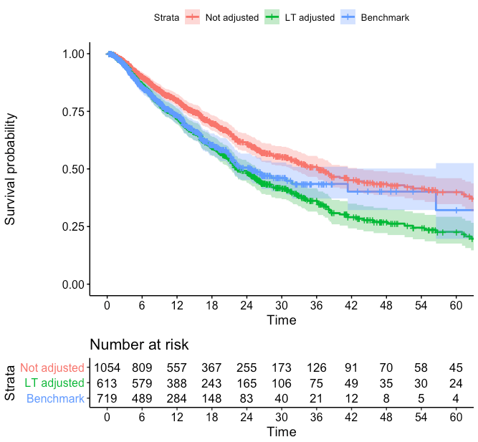
Left truncation example
Left truncation in months:
Time | N
0 | 579
0-3 | 215
3-6 | 30
6-12 | 58
>12 | 172

Slide 5
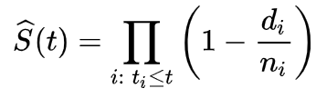
Methods: Dealing with left-truncation 1
For regression methods we use the Kaplan-Meier estimator of the survival function:
We can easily estimate this using the Surv(time1,time2,status) function in R
Given the high-dimensionality of the data we want to use a penalized method. The penalized package in R enables us to perform a penalized Cox regression with a combination:
Gradient ascent
Newton-Raphson
5 internal cross-validations

Slide 6
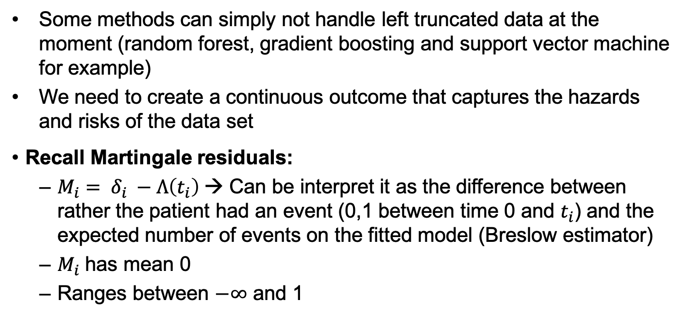
Methods: Dealing with left-truncation 2
Some methods can simply not handle left truncated data at the moment (random forest, gradient boosting and support vector machine for example)
We need to create a continuous outcome that captures the hazards and risks of the data set
Recall Martingale residuals:
${M_{i}= δ}_{i} −Λ\left(t_{i}\right)$→ Can be interpret it as the difference between rather the patient had an event (0,1 between time 0 and $t_{i}$) and the expected number of events on the fitted model (Breslow estimator)
$M_{i}$ has mean 0
Ranges between $−∞$ and 1

Slide 7
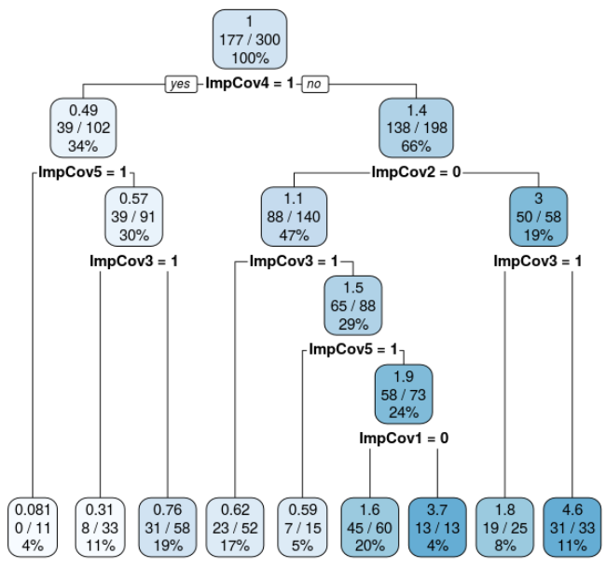
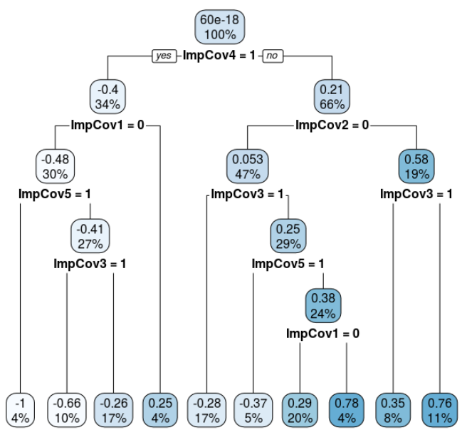
Martingale residuals as outcome
Survival tree
Martingale residual tree

Slide 8
Methods: Ensemble learning
Cross-validation
Reduces overfitting
Leads to unbiased estimates
Model
Prediction
Model
Prediction
Final prediction
Average the prediction of all test set predictions
.
.
.
Model
Prediction
Model
Prediction

Slide 9
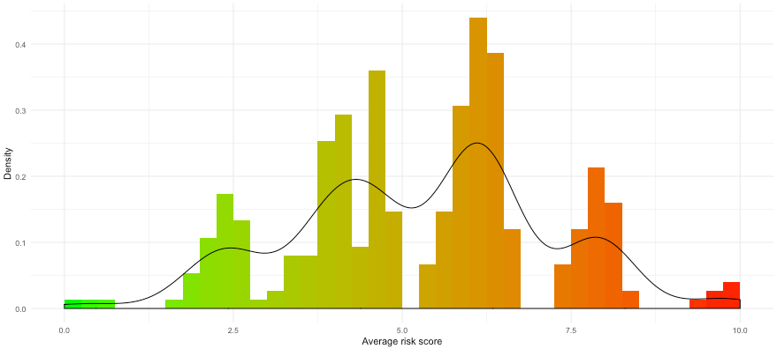
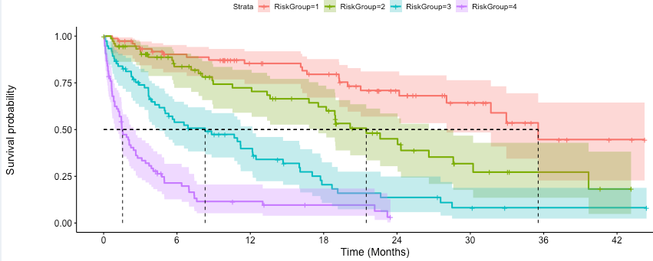
Methods: Risk Stratification
We can use the distribution of the average predicted risk score to stratify patients in different groups
Final prediction
Average the prediction of all test set predictions
Visual
Clinical
Clusters
Risk group genetics and clinical properties

Slide 10
Available methods
Penalized Methods
Least absolute shrinkage and selection operator (LASSO)
Elastic-Net (ENET)
Good for sparse mutational data
ENET can handle correlated data and improve prediction but more computationally intensive than LASSO
Gives coefficients for features
Tree based methods
Random Forest (RF)
Gradient boosting (GBM)
Good for highly correlated data
GBM is more accurate than RF but requires more tuning
Do not give coefficients, black box methods oriented towards performance

Slide 11
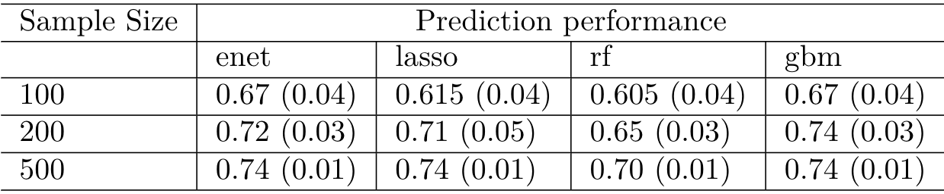
Results: Simulations (1)
Median and standard deviation of the concordance probability at each cross-validation for all methods available
GBM is the best performer
ENET and LASSO are very similar
Scenario favorises regression methods over tree based methods

Slide 12
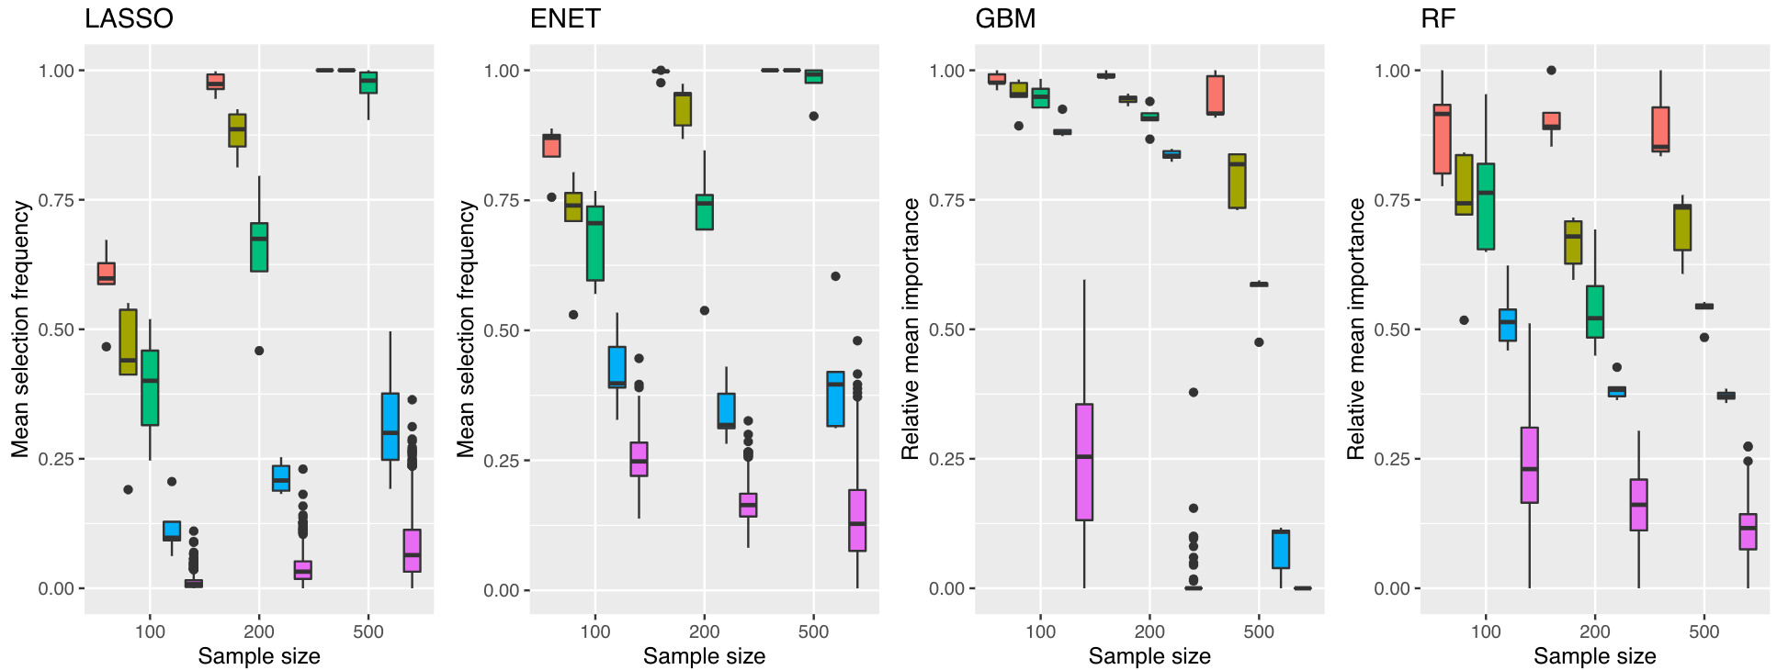

Results: Simulations (2)

Slide 13
Results: LUAD example (1)
Metastatic adenocarcinoma patients at MSKCC (n=1054)
Genomic data
Clinical data
OncoCast Methods
Mutations:
IMPACT curated panel of 340 cancer genes
Binary system, wild vs mutant
Demographics:
Age
Sex
Smoking status
Continuous variables were dichotomized into binary variables.
Undergoing standard care
Elastic-net
200 cross-validations
2/3 training set; 1/3 testing set
All covariates were penalized
Fusions:
ALK
ROS1
MET
Risk Groups (4):
R1: 0-25%; R2: 25-75%; R3: 75-90%; R4: 90-100%

Slide 14
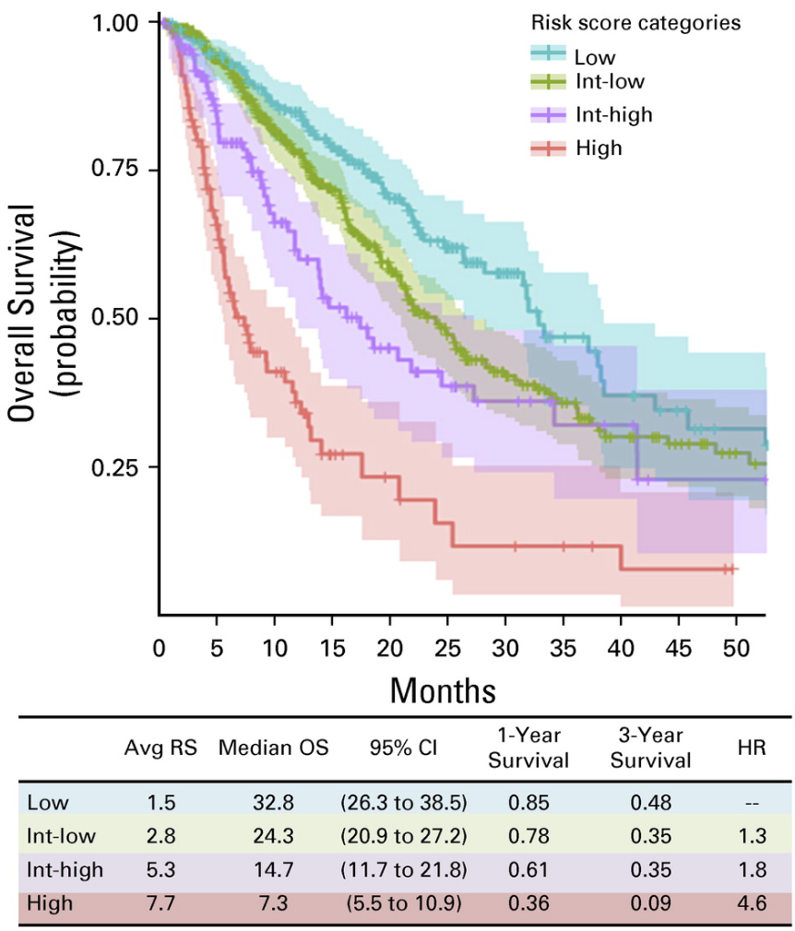
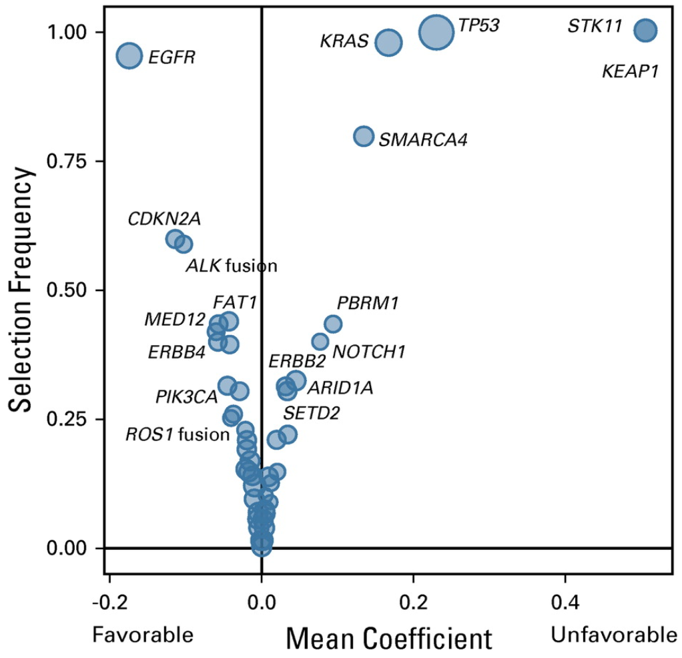
Results: LUAD example (2)

Slide 15
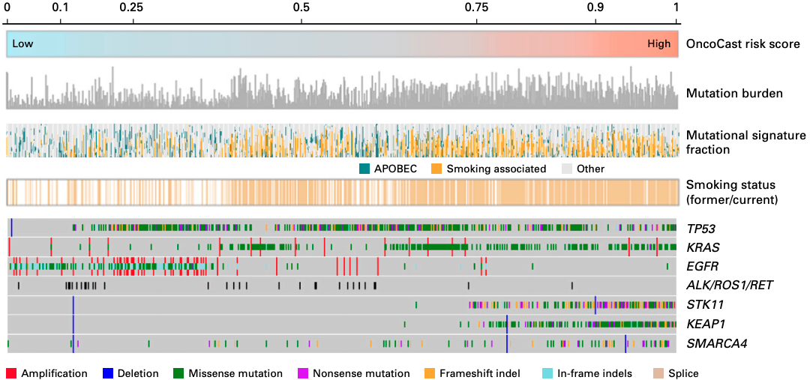
Results: LUAD example (3)

Slide 16
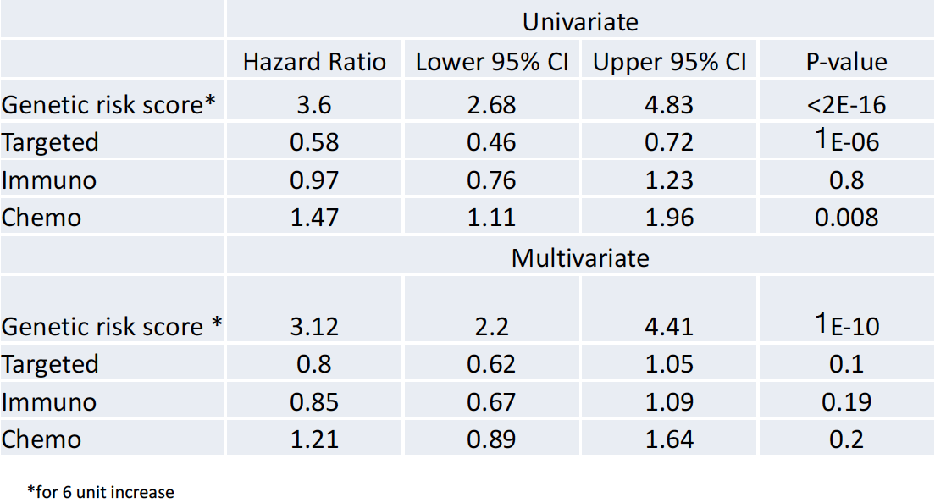
Results: LUAD example (4)
Classifier is based on clinical grade sequencing as part of routine care highlights immediate application and strong practical utility
OncoCast classification substantially outperformed all the individual genes as a predictor of overall survival
OncoCast risk score remained a highly significant predictor after adjusting for clinical variables and treatment types as potential confonding factors in a multivariate Cox regression model

Slide 17
App

Slide 18
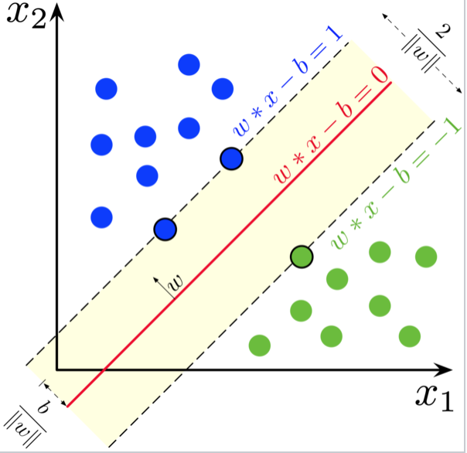
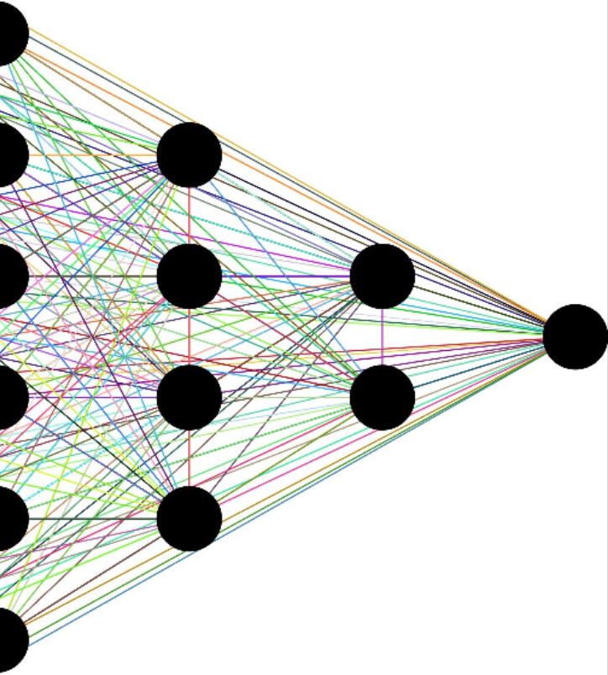
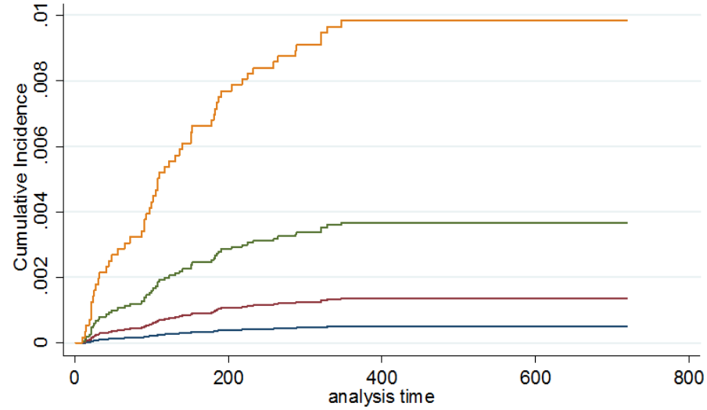
Discussion and future work
Support vector machine
Neural network
Competing risk analysis
LASSO
Stacking
Final prediction
ENET
Metalearner
RF
GBM

Slide 19



Thank you notes and resources
How to contact me
Email: axel.steph.martin@gmail.com
LinkedIn: https://www.linkedin.com/in/axel-martin-202b9581/
Twitter: @Claunderer
Dr. R. Shen
Dr. G. Riely
Scan this with the camera on your phone to get a link to my github and the package
Andy (Ai) Ni

Slide 20
References
Goeman,JJ (2010) L1 penalized estimation in the Cox proportional hazards model. <i>Biometrical journal 52: 70–84
Leo Breiman (2001) Classification and regression based on a forest of trees using random inputs, based on Breiman. Machine Learning
Ridgeway, G. (2006) Generalized boosted regression models. Documentation on the R Package ‘gbm’, version 1·5–7. http://www.i‐pensieri.com/gregr/gbm.shtml, accessed March 2008.
Keles,S., Segal, M.R. (2002) Residual-based tree-structured survival analysis. Statistics in medicine 21:313-326
Shen,R. (2019) Harnessing Clinical Sequencing Data for Survival Stratification of Patients With Metastatic Lung Adenocarcinomas. JCO Precision Oncology 2019 :3, 1-9

